Slide 1
Lab 1
Introduction to System Verilog

Slide 2


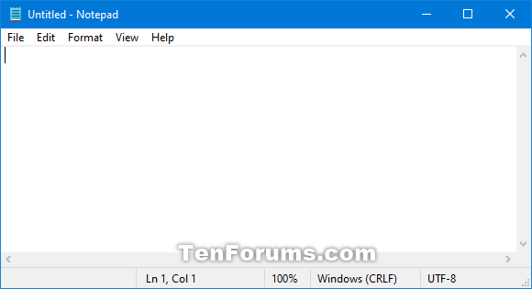
Code Editor
Sublime Text
VS Code
Notepad

Slide 3
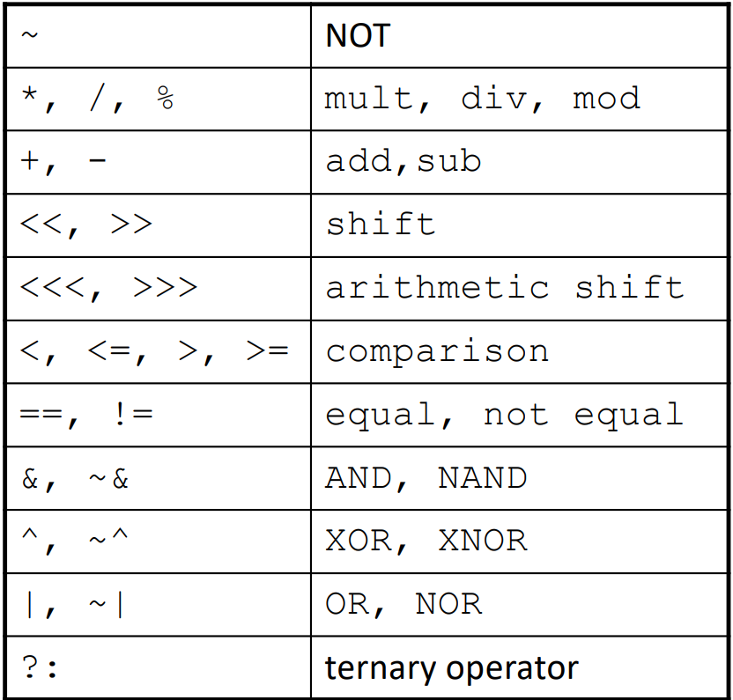
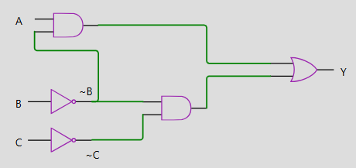
Ckt1
Output, Y = A and (not B) or (not B) and (not C)

Slide 4
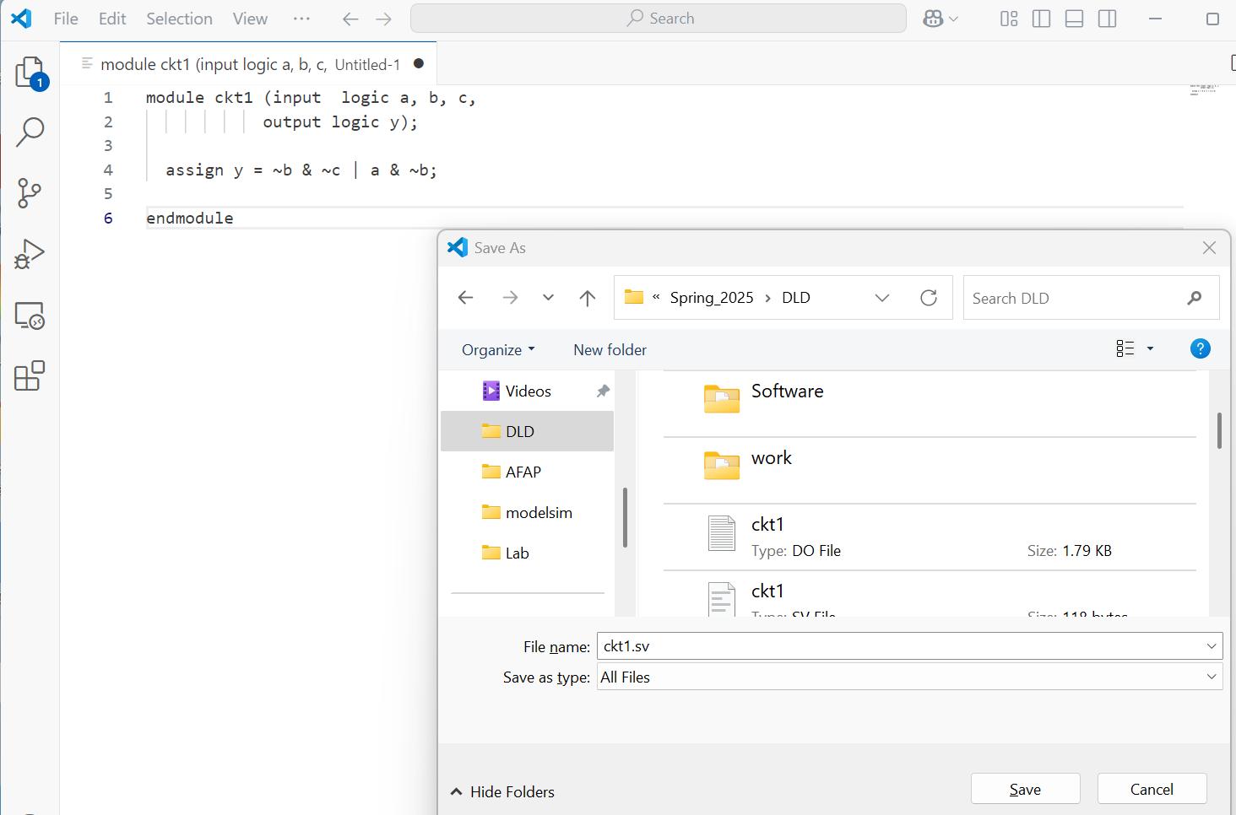
Let’s Write the Circuit in System Verilog
Step1: Open any code editor (I am using VScode here)
Step2: Write down the code
Step3: Name it as ckt1.sv and
save as “ALL FILES” types

Slide 5
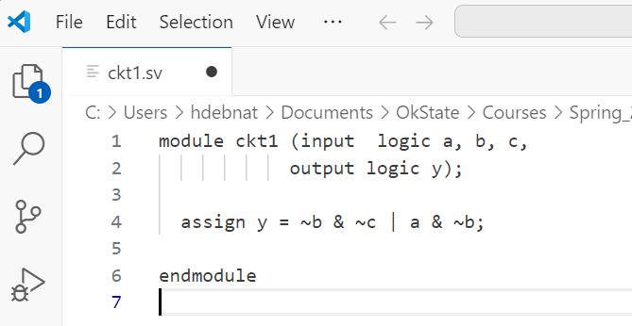
Let’s Write the Circuit in System Verilog
Module name
Inputs & Output
“assign” command
Circuit’s eqtn
endmodule

Slide 6
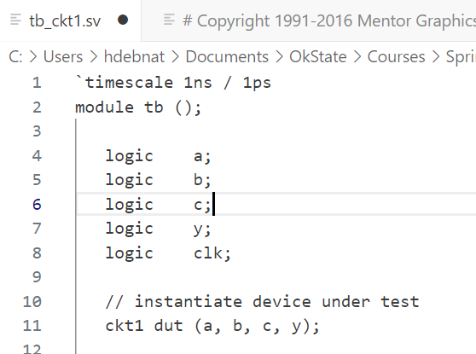
Testbench_1
**download testbench and do file from canvas and make necessary changes accordingly.
Testbench Module name
Input Output Ports name
Circuit’s module name

Slide 7
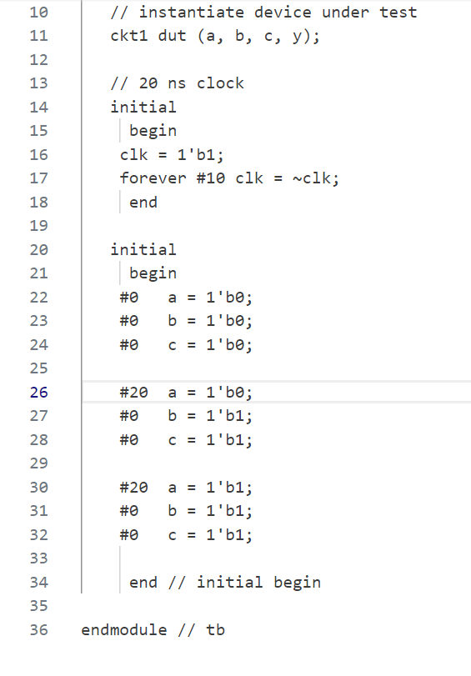
Testbench_2
Setting up input waveforms
Here, we use binary inputs
Save the testbench as tb_ckt1.sv
end testbench module

Slide 8
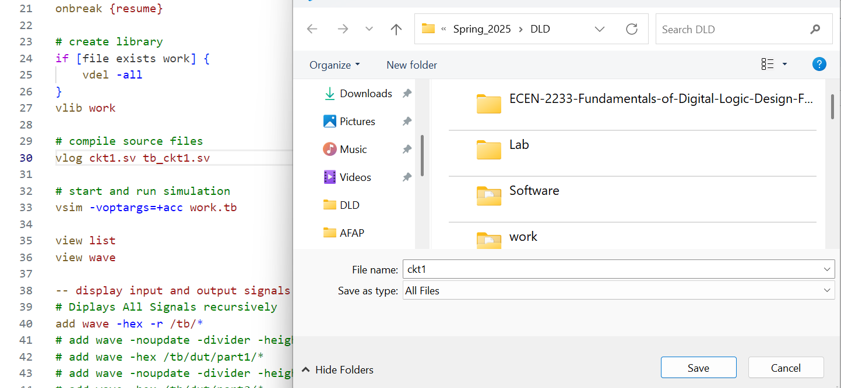
DO file
onbreak {resume}
# create library
if [file exists work] {
vdel -all
}
vlib work
# compile source files
vlog ckt1.sv tb_ckt1.sv
# start and run simulation
vsim -voptargs=+acc work.tb
view list
view wave
-- display input and output signals as hexidecimal values
# Diplays All Signals recursively
add wave -hex -r /tb/*
add list -hex -r /tb/*
add log -r /*
-- Set Wave Output Items
TreeUpdate [SetDefaultTree]
WaveRestoreZoom {0 ps} {75 ns}
configure wave -namecolwidth 150
configure wave -valuecolwidth 100
configure wave -justifyvalue left
configure wave -signalnamewidth 0
configure wave -snapdistance 10
configure wave -datasetprefix 0
configure wave -rowmargin 4
configure wave -childrowmargin 2
-- Run the Simulation
run 250 ns
Step1: Need to change the name ckt1.sv & tb_ckt1.sv accordingly
Step2: save the file as ckt1.do as “ALL FILES” types

Slide 9
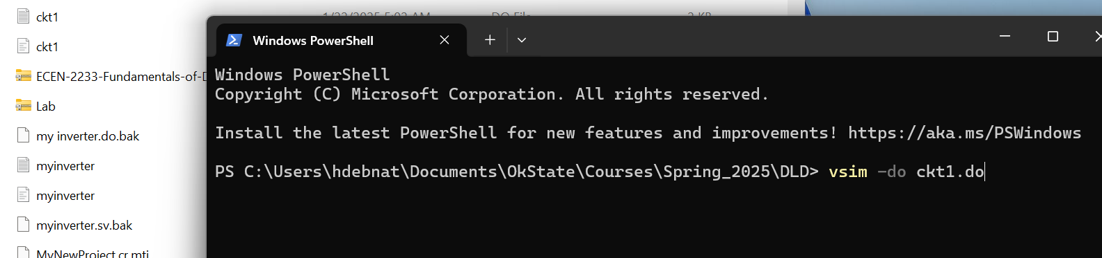
Now open the command terminal
#Use this run.do file to run this example.
# Either, to run from a shell, type the following at the shell prompt:
vsim -do ckt1.do -c
# (omit the "-c" to see the GUI while running from the shell)
# or, bring up ModelSim and type the following at the "ModelSim>" prompt:
do ckt1.do

Slide 10
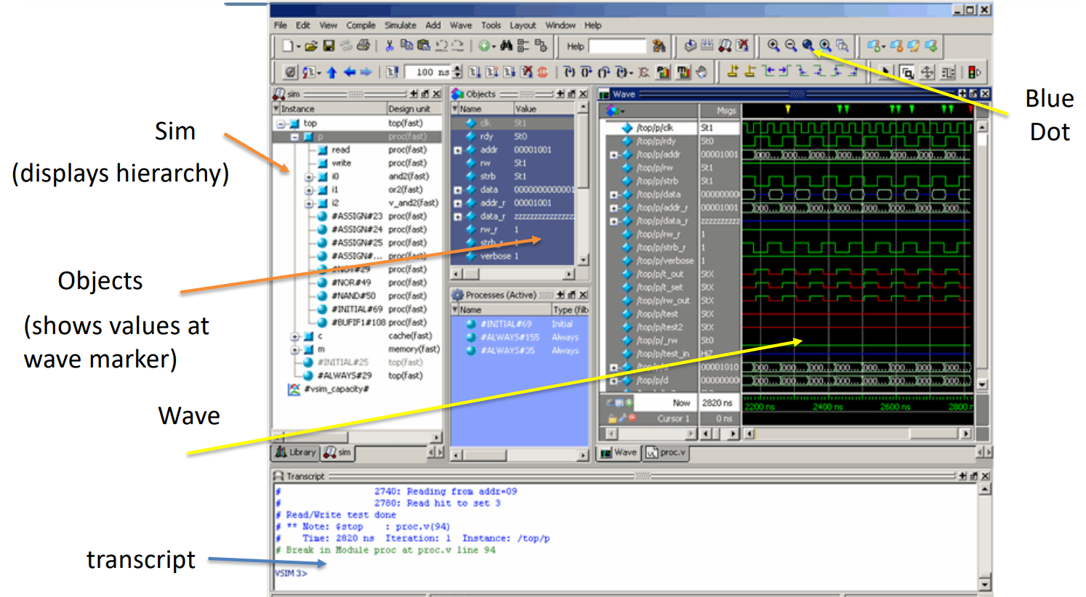
Key Parts of GUI(VSIM)

Slide 11
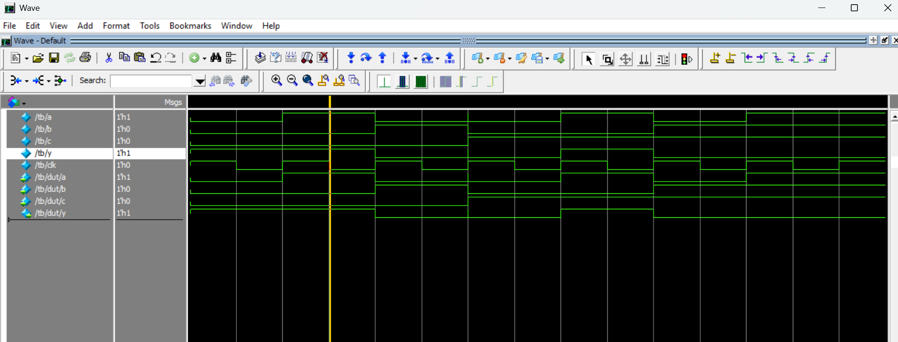
Waveform:

Slide 12
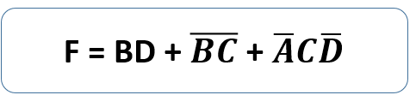
Let’s find out the truth table and check whether you get correct waveform or not.
Circuit 2
Draw the circuit
truth table
sv file
testbench file
do file
waveform

